Slide 1


Vivekananda College of Engineering & Technology
[A Unit of Vivekananda Vidyavardhaka Sangha, Puttur®] Affiliated to Visvesvaraya Technological University, Belagavi
Approved by AICTE New Delhi & Recognised by Govt of Karnataka
Major Project Presentation on
“EEG-HDC” – EEG Based Hierarchical Detection & Classification of Seizures.
Guided by
Prof. Pradeep Kumar K G
HoD, CSE
Presented by
Aashitha Prabhu B (4VP23CS001) Abhayraj Bhat N (4VP23CS002) Adithya (4VP23CS004)
Ashwini (4VP23CS017)
DEPARTMENT OF COMPUTER SCIENCE & ENGINEERING 2025-26

Slide 2
Contents
Introduction
Problem Statement
Objectives
Literature review
Architecture Diagram
Expected Outcomes

Slide 3
Introduction
A seizure is a sudden abnormal electrical activity in the brain, analyzed using EEG signals that record multi-channel brain activity. This project proposes a hierarchical deep learning framework that first detects seizure segments and then classifies them into Focal, Focal to Bilateral Tonic-Clonic, and Generalized Tonic-Clonic types using transfer learning to improve classification.

Slide 4
Problem Statement
To detect and accurately classify seizure events into their respective subtypes from EEG signals for clinical applications using advanced deep learning methodologies.

Slide 5
Objectives
To acquire and preprocess EEG datasets through signal cleaning, filtering, normalization, and segmentation.
To develop a hierarchical deep learning framework for seizure detection and subsequent seizure subtype classification using transfer learning.
To implement hybrid model and evaluate an automated multi-class seizure subtype classification system using subject-wise validation metrics.

Slide 6
Sl. No | Reference Paper | Advantages | Limitations
1 | N. Ilakiyaselvan, A. Nayeemulla Khan, and A. Shahina - Deep learning approach to detect seizure using reconstructed phase space images | Effectively captures nonlinear EEG dynamics and achieves high accuracy (~98.5%). The use of RPS with CNN improves representation of complex patterns. | Requires conversion of signals into images, increasing preprocessing steps. This adds computational overhead and complexity to the pipeline.
2 | S. Srinivasan, Sundaranarayana Dayalane, Sandeep Kumar Mathivanan, Hariharan Rajadurai, Prabhu Jayagopal, and Gemmachis Teshite Dalu - Detection and classification of adult epilepsy using hybrid deep learning approach | 3D-DCAE + Bi-LSTM achieved very high performance (≈99.08% accuracy, 99.16% F1) on CHB-MIT paediatric EEG. The end-to-end supervised autoencoder is trained once, reducing parameters via convolutional layers and compressing EEG into a low-dimensional latent space for a compact, high-precision classifier. | Evaluated only on the CHB-MIT dataset (23 paediatric patients), so its performance on adult or larger cohorts is untested. It performs only binary (ictal vs. interictal) classification, ignoring multiple seizure types and pre-ictal states, which may limit clinical applicability.
3 | Hezam Albaqami, G. M. Hassan, and A. Datta - Wavelet-Based Multi-Class Seizure Type Classification System | Using TUH EEG Seizure Corpus (TUSZ v1.5.2) (3050 seizures, 300+ patients), the method classifies seven seizure types with ~96.0% accuracy and 99.1% weighted F1 (seizure-wise). DTCWT features with LightGBM set a new benchmark, outperforming prior methods. | Patient-wise evaluation drops to 74.7% F1, indicating poor cross-subject generalization. The method uses fixed wavelet features with LightGBM, lacks end-to-end learning, and is not validated on independent or noisy datasets.

Slide 7
4 | A. Abdelhameed and M. Bayoumi - A Deep Learning Approach for Automatic Seizure Detection in Children With Epilepsy | Achieves high accuracy (~98.8%) with automatic feature learning. Requires minimal preprocessing using deep learning models. | Performance is dataset-specific and may not generalize well. High computational cost limits practical deployment.
5 | M. Guendelman, R. Vekslar, and O. Shriki - A New Perspective in Epileptic Seizure Classification: Applying the Taxonomy of Seizure Dynamo types to Non-invasive EEG and Examining Dynamical Changes across Sleep Stages | Provides interpretable seizure dynamics and links them with sleep stages. Offers a scalable and explainable modeling approach | Depends on manual labeling which increases effort. Performance is sensitive to noise in EEG signals.
6 | M. K. Siddiqui, R. Morales-Menendez, X. Huang, and N. Hussain - A review of epileptic seizure detection using machine learning classifiers | Gives a comprehensive comparison of classifiers and identifies strong models. Helps understand effectiveness of traditional ML techniques. | Lacks experimental validation to support conclusions. Limited focus on deep learning approaches.
7 | Y. Yuan et al. - A Transformer‐Based Framework With Data Augmentation for Robust Seizure Detection Across Invasive and Non-invasive Neural Recordings | Provides high generalization and eliminates need for manual feature extraction. Uses attention mechanisms effectively with augmented data. | Sensitive to noise in EEG signals. High computational cost makes it resource intensive.
8 | P. A. Akor, G. Enemali, U. Muhammad, R. R. Singh, and H. Larijani - An Attention-Residual Convolutional Network for Real-Time Seizure Classification on Edge Devices | Achieves very high accuracy and supports real-time edge deployment. Combines attention and residual learning for efficient performance. | Relies on handcrafted features which limits automation. Feature dependency may affect scalability.

Slide 8
10 | A. Ulate-Campos, F. Coughlin, M. Gaínza-Lein, I. S. Fernández, P. L. Pearl, and T. Loddenkemper - Automated seizure detection systems and their effectiveness for each type of seizure | Offers practical insights using multi-sensor systems like EEG and ECG. Helps in selecting suitable devices for detection. | Does not provide a unified detection framework. Integration across systems remains unclear.
11 | U. R. Acharya, Y. Hagiwara, and H. Adeli - Automated seizure prediction | Covers advanced prediction techniques using ML models. Explores feature engineering for improved forecasting. | Reliability is lower compared to detection systems. Prediction accuracy is still a major challenge.
12 | X. Wei, L. Zhou, Z. Chen, L. Zhang, and Y. Zhou - Automatic seizure detection using three-dimensional CNN based on multi-channel EEG | Captures spatial and temporal EEG features effectively. Improves detection using multi-channel modeling. | Requires complex data representation and processing. Increases computational burden significantly.
13 | R. San-Segundo, M. Gil-Martín, L. F. D’Haro-Enríquez, and J. M. Pardo - Classification of epileptic EEG recordings using signal transforms and convolutional neural networks | Achieves very high accuracy (~99.5%) using hybrid techniques. Combines signal transforms with deep learning effectively. | Strong dependence on preprocessing techniques. Performance varies based on transform quality.
14 | Y. Wang, Y. Shi, Z. He, Z. Chen, and Y. Zhou - Combining temporal and spatial attention for seizure prediction | Captures both spatial and temporal dependencies in EEG data. Achieves high accuracy (98.25%) with very low false positives. | Model complexity is high due to combined architectures. Requires structured multi-channel EEG data.

Slide 9
15 | L. Bai, G. Litscher, and X. Li - Epileptic Seizure Detection Using Machine Learning: A Systematic Review and Meta-Analysis | Improves performance through model fusion techniques. Achieves good accuracy (~96.17%). | Ensemble increases model complexity. Generalization analysis is limited.
16 | I. Jemal, L. Abou-Abbas, Khadidja Henni, Amar Mitiche, and Neila Mezghani - Domain adaptation for EEG-based, cross-subject epileptic seizure prediction | Improves generalization across different patients. Achieves ~10% accuracy improvement. | Still affected by domain shift issues. Requires large multi-patient datasets.
17 | B. Priya Prathaban and R. Balasubramanian - Dynamic learning framework for epileptic seizure prediction using sparsity based EEG Reconstruction with Optimized CNN classifier | Provides high performance (~98% accuracy) and early prediction (~1.1 hr prior). Reduces false positives significantly. | Pipeline is complex with multiple stages. Computational cost is high due to processing steps.
18 | S. Raghu, N. Sriraam, Y. Temel, S. V. Rao, and P. L. Kubben - EEG based multi-class seizure type classification using convolutional neural network and transfer learning | Enables effective multi-class classification using pretrained models like AlexNet and InceptionV3. Improves learning efficiency through transfer learning techniques. | Achieves only moderate accuracy (~88%) compared to advanced models. Requires spectrogram conversion which adds preprocessing complexity.
19 | S. Wong et al. - EEG datasets for seizure detection and prediction— A review | Improves dataset selection and enhances reproducibility in research. Provides useful insights into ML pipeline design. | Does not include experimental validation of methods. Relies entirely on existing studies and datasets.
20 | A. A. Ein Shoka, M. M. Dessouky, A. El-Sayed, and E. E.-D. Hemdan - EEG seizure detection: concepts, techniques, challenges, and future trends | Offers a comprehensive overview of detection pipelines and techniques. Identifies key challenges and future research directions. | Lacks quantitative benchmarking for comparison. Does not provide experimental performance results.

Slide 10
21 | W. Cao, Q. Li, A. Zhang, and T. Wang - Efficient and Accurate Epilepsy Seizure Prediction and Detection Based on Multi-Teacher Knowledge Distillation RGF-Model | Achieves very high accuracy (99%+) with lightweight and real-time capability. Efficiently transfers knowledge across models. | Architecture is complex and difficult to design. Implementation may require careful tuning and optimization.
22 | N. McCallan et al. - Epileptic multi-seizure type classification using electroencephalogram signals from the Temple University Hospital Seizure Corpus: A review | Highlights best-performing deep learning models for seizure classification. Provides comparative insights across multiple approaches. | Lacks standardization across studies and datasets. Results may not be directly comparable.
23 | M. Zhou et al. - Epileptic Seizure Detection Based on EEG Signals and CNN | Achieves high accuracy (~97%) without manual feature extraction. Learns features directly from raw EEG signals. | Performance depends heavily on signal representation. Different domains may affect accuracy.
24 | A. T. Tzallas, M. G. Tsipouras, and D. I. Fotiadis - Epileptic Seizure Detection in EEGs Using Time–Frequency Analysis | Effectively handles non-stationary EEG signals using time-frequency methods. Improves feature representation quality. | Feature extraction pipeline is complex and time-consuming. Requires multiple transformation steps.
25 | A. Subasi, J. Kevric, and M. Abdullah Canbaz - Epileptic seizure detection using hybrid machine learning methods | Achieves very high accuracy (~99.38%) with optimized parameters. Combines DWT and SVM effectively. | Requires handcrafted features which limit automation. Model performance depends on feature quality.
26 | M. S. Farooq, A. Zulfiqar, and S. Riaz - Epileptic Seizure Detection Using Machine Learning: Taxonomy, Opportunities, and Challenges | Provides a comprehensive taxonomy and identifies research gaps. Helps guide future work in seizure detection. | Does not include experimental validation. Focus remains theoretical and descriptive.

Slide 11
27 | E. Ali, M. Angelova, and Chandan Karmakar - Epileptic seizure detection using CHB-MIT dataset: The overlooked perspectives | Performs real-world evaluation handling imbalance and variability. Provides practical insights using Random Forest. | Shows moderate sensitivity (~75%) in detection. Pipeline is relatively complex.
28 | A. Shoeibi et al. - Epileptic Seizures Detection Using Deep Learning Techniques: A Review | Provides a comprehensive overview of deep learning models. Identifies best-performing architectures for seizure detection. | No experimental validation is included. Analysis remains high-level and descriptive.
29 | T. K. Murugan and A. Kameswaran - Employing convolutional neural networks and explainable artificial intelligence for the detection of seizures from electroencephalogram signal | Improves interpretability and clinical trust using XAI techniques. Maintains good accuracy in detection. | Adds extra complexity due to explainability methods. Performance depends on feature quality.
30 | S. Cuyckens, R. Antonio, C. Fang, and M. Verhelst - iEEG Seizure Detection with a Sparse Hyperdimensional Computing Accelerator | Offers very low energy consumption and supports real-time detection. Suitable for hardware-efficient implementations. | Implementation is complex and hardware-dependent. Validation scope is limited.
31 | P. Thodoroff, J. Pineau, and A. Lim - Learning Robust Features using Deep Learning for Automatic Seizure Detection | Learns robust cross-patient features without manual extraction. Improves generalization across datasets. | Computationally intensive and resource-demanding. Performance depends on data quality.
32 | Th. Sverrisson and S. Gudmundsson - LookAroundNet: Extending Temporal Context with Transformers for Clinically Viable EEG Seizure Detection | Captures long-range dependencies and improves generalization. Provides strong performance using temporal context modeling. | High computational cost due to transformer models. Requires large-scale datasets.

Slide 12
33 | Giorgos Giannakakis, Vangelis Sakkalis, M. Pediaditis, and Manolis Tsiknakis - Methods for Seizure Detection and Prediction: An Overview | Provides a comprehensive comparison of detection methods. Achieves high accuracy using engineered features. | Relies on handcrafted features rather than deep learning. Limited modern DL-based insights.
34 | Y. Yang, K. Guo, Z. Fang, H. Lin, M. Grosser, and J. Lu - Multi-model Transfer Learning and Genotypic Analysis for Seizure Type Classification | Improves accuracy by 13–16% and handles data scarcity. Combines multiple models for better performance. | Architecture is complex and difficult to manage. Requires multi-source data integration.
35 | D. Ahmedt-Aristizabal, T. Fernando, S. Denman, L. Petersson, M. J. Aburn, and C. Fookes - Neural Memory Networks for Seizure Type Classification | Captures long-term dependencies and achieves high F1-score (~0.945). Enhances sequence modeling capability. | High model complexity increases computation. Limited dataset availability affects training.
36 | S. Ghosh, V. Singh, and O. S. Powar - Seizure detection using EEG on the CHB-MIT dataset via multi-domain feature engineering and classical machine learning | Provides interpretable results with low latency. Supports patient-independent evaluation. | Lower accuracy compared to deep learning models. Performance may be limited.
37 | M. L. Scheuer, S. B. Wilson, A. Antony, G. Ghearing, A. Urban, and A. I. Bagić - Seizure Detection: Interreader Agreement and Detection Algorithm Assessments Using a Large Dataset | Demonstrates expert-level algorithm performance. Compares human and algorithm outputs effectively. | Highlights variability and lack of perfect ground truth. Evaluation uncertainty remains.

Slide 13
38 | S. Roy, U. Asif, J. Tang, and S. Harrer - Seizure Type Classification Using EEG Signals and Machine Learning: Setting a Benchmark | Provides benchmark study for multi-class classification. Uses multiple ML models for comparison. | Poor generalization in patient-wise validation. Performance varies across datasets.
39 | C. Baumgartner and J. P. Koren - Seizure detection using scalp-EEG | Provides clinical insights and performance ranges. Useful for understanding real-world applications. | Not a specific model and lacks implementation details. Limited practical usability.
40 | U. Asif, S. Roy, J. Tang, and S. Harrer - SeizureNet: Multi-Spectral Deep Feature Learning for Seizure Type Classification | Achieves high F1-score (~0.94) with strong feature representation. Uses multi-spectral features effectively. | Shows moderate generalization performance. Patient-wise F1-score is relatively low (~0.59).
41 | SeizureTransformer: Scaling U-Net with Transformer for Simultaneous Time-Step Level Seizure Detection from Long EEG Recordings | Captures long-range dependencies and achieves state-of-the-art performance. Combines CNN and transformer effectively. | High computational cost and complex architecture. Requires significant resources.
42 | W. Weng et al. - Self-supervised Learning for Electroencephalogram: A Systematic Survey | Reduces dependency on labeled data and improves generalization. Explores multiple SSL strategies. | Requires careful design of pretext tasks. Training process is complex.
43 | J. J. Falco-Walter, I. E. Scheffer, and R. S. Fisher - The new definition and classification of seizures and epilepsy | Provides standardized labels improving dataset consistency. Supports better machine learning applications. | Not a predictive model or algorithm. Lacks computational framework.

Slide 14
44 | L. Wei and C. Mooney - Transfer Learning-based Seizure Detection on Multiple Channels of Paediatric EEGs | Achieves good accuracy (~85%) with reduced training cost. Supports multi-channel data fusion. | Depends on spectrogram transformation. Scalability is moderate.
45 | H. Banville, O. Chehab, A. Hyvärinen, D.-A. Engemann, and A. Gramfort - Uncovering the structure of clinical EEG signals with self-supervised learning | Works effectively with unlabeled data and learns robust features. Provides strong generalization. | Training is complex and requires careful task design. Computational effort is high
46 | A. Shoeibi et al. - Automatic Diagnosis of Schizophrenia in EEG Signals Using CNN-LSTM Models | Achieves very high accuracy (~99.25%) with strong spatial-temporal learning. Reduces need for manual feature extraction. | Dataset is small (28 subjects) limiting generalization. Focuses only on binary classification.

Slide 15
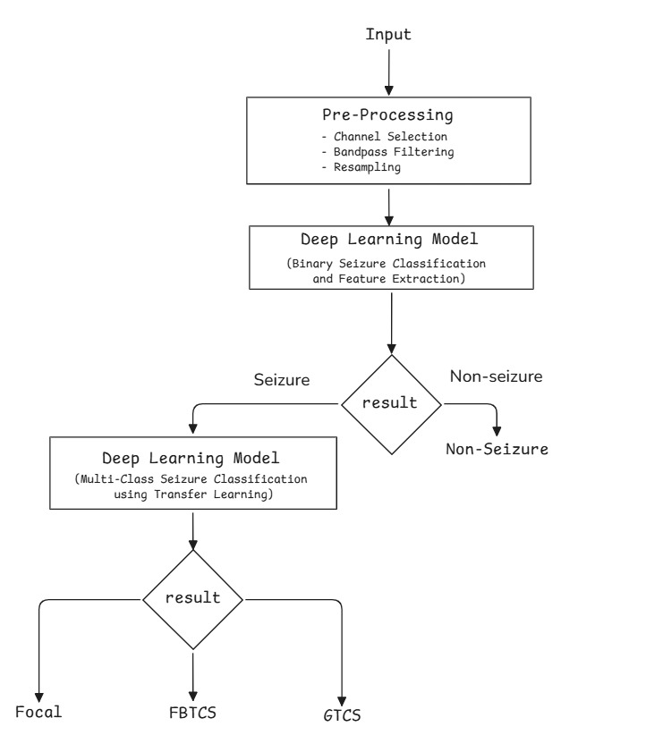
Architecture diagram

Slide 16
Expected Outcomes
A standardized and pre-processed EEG dataset with cleaned, filtered, normalized, and segmented seizure recordings suitable for deep learning analysis.
A functional hierarchical deep learning framework capable of performing seizure detection followed by seizure subtype classification using transfer learning.
An evaluated automated multi-class seizure classification system with validated performance metrics (e.g., accuracy, precision, recall, F1-score) using subject wise cross validation.

Slide 17
THANK YOU

